Slide 1
CIS 509 Course Project
Sentiment analysis and Topic Modeling on US Pizza Restaurants in 2017 and 2018
Notes:
Good morning to one and all present here. Today my team and I will be presenting our course project for CIS 509. Our project focuses on performing sentiment analysis and topic modeling on US Pizza Restaurants reviews from 2017 and 2018.

Slide 2
Business Context of Pizza Restaurants
As of 2022, over the last 10 years
$47B market
3% Compound annual growth rate
Competitive environment - Low cost of entry into the market
Need to be up to date – defend and grow their restaurants
Notes:
As of 2022, pizza restaurant is a $47B market, with a 3% CAGR (Compound annual growth rate) over the last 10 years. The market is extremely competitive with more than 80,000 pizza restaurants. And new pizza restaurants continue to be opened as the cost of entry into this market is relatively low. In this competitive environment, it is important for pizza restaurant operators to be up to date with the latest customer preferences so that they can respond accordingly to defend and grow their restaurants.

Slide 3
Problem Statement
To analyze Yelp customer reviews for all US pizza restaurants from 2017 and 2018 by performing Sentiment Analysis and Topic Modeling to identify root causes of customer satisfaction and dissatisfaction.
Notes:
We chose 2017 and 2018 as the years because these were the latest years before the covid-19 pandemic. We know that during and after the pandemic, people did not frequent restaurants as often as they did before and thus, we would have relatively less data to work with. We wanted to work with as much data as possible.

Slide 4
Data Identification and acquisition process
Business Dataset | Review Dataset
Target business and industry: Pizza Restaurants. | Json file too large to load at once – load it in chunks of 1000000 and append
Remove rows in which ‘categories’ column is null. | Target years: 2017-2018
Consider rows which have ‘pizza’, ‘restaurant’, ‘pie’, ‘slice’ in their categories | Filter dataset for target years data
Remove rows which have more than 3 categories
Join the filtered business and review dataset on the business id to get final dataset to work on.
Data cleaning – removing stop words and performing lemmatization
Notes:
To perform any kind of data analysis we need to first identify the data required to perform the analysis and then acquire / collect it. Since we want to understand the root causes for customer satisfaction and dissatisfaction for pizza restaurants, we need their reviews on them. We got this unstructured data from the Yelp reviews website API. This data had multiple json files.
1. The business json file had information about the all the different types of business in different industries on which people gave their reviews on Yelp. So, we loaded the entire business json file as a pandas dataframe. We then filtered this dataframe to get information only about those businesses that are relevant to our problem statement – pizza restaurants.
We removed the rows for which there was a null column in the ‘categories’ column, because we majorly use this column to filter the dataset.
We grabbed all those rows that had ‘pizza’, ‘restaurant’, ‘pie’ or ‘slice’ in their categories column.
We then removed those rows that had more than 3 categories – these businesses fell into categories other than pizza and restaurants and are thus irrelevant to us.
Now that we had the pizza restaurants businesses, we needed reviews for them. So we used the reviews json file. This file was too big to load all at once, so we loaded them in chunks of 100000 and then appended them all together.
We filtered out this dataset by grabbing only those rows from 2017 and 2018.
We then joined the 2 filtered datasets together to get the final dataset we want to work with.
Once we acquired the data, as a part of data cleaning, we got rid of the stop words and also performed lemmatization.

Slide 5
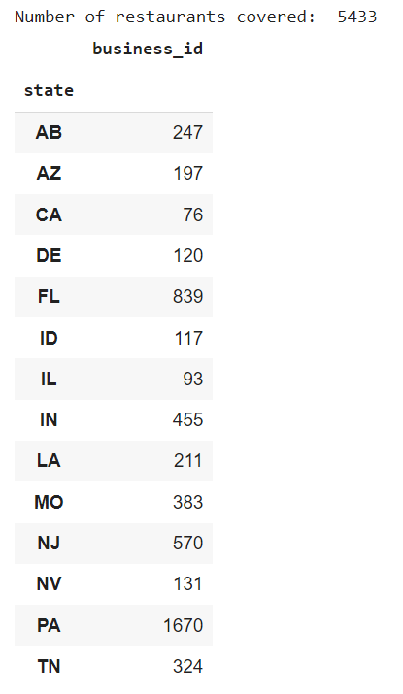
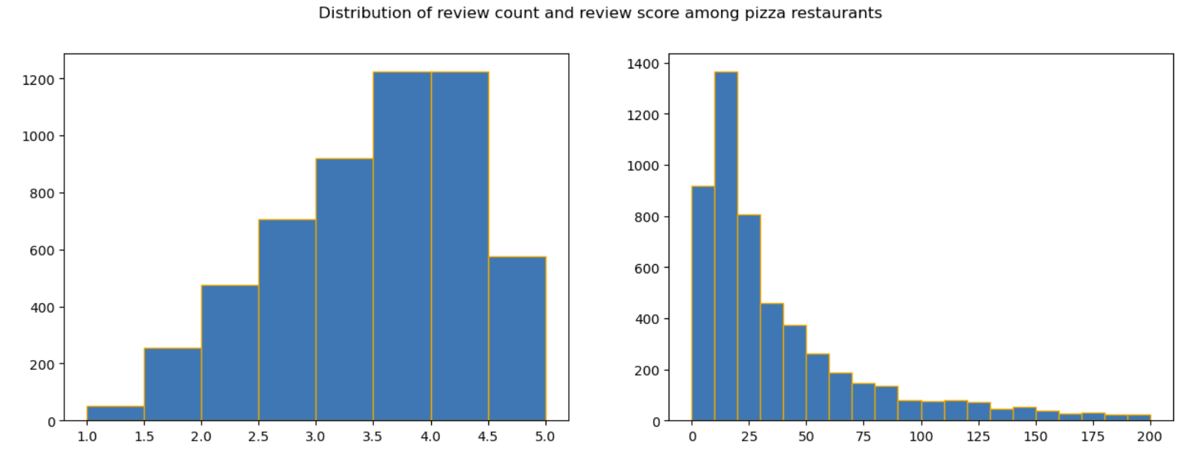
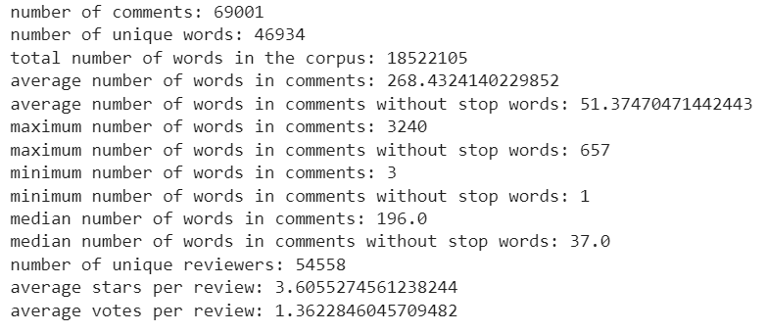
Data summary – Descriptive analytics
Notes:
So, this is a brief summary of the dataset we worked with:
The dataset has 5433 pizza restaurants across different states in the US.
You can see from the distribution that most of the ratings are in the range of 3.5 to 4.5
We also performed some term statistics to understand the volume of data we will be working with:
We have approximately 69000 reviews. The corpus has over a billion words. The total number of unique words are approximately 46000. On an average, there are 268 words in a review. Without stop words we have approximately 50 words in a review. We thus have a lot of data to work with.

Slide 6
Data acquired justification
Representativeness
Sample size
Bias
5433 pizza restaurants across all states in the US.
It is representative for our problem statement.
69K reviews from 55K reviewers about more than 5000 pizza restaurants.
Sufficient sample size to build a model .
Star rating dominated by 4, 4.5 and 5 stars.
Does not represent bias.
Good restaurants -> attract customers -> survive better -> more reviews
Notes:
Let's talk about the justification of the data acquired before we delve into the analysis.
a. The data covers more than 5000 businesses across all the states in the original Yelp dataset and are more certain to be pizza restaurants so it is suitable for our business questions. Thus, our data is representative with respect to our problem statement. b. The sample size include 69K reviews from 55k reviewers so it is sufficiently large for us to build our model. c. The star rating are dominated by 4, 4.5, and 5 stars. However, we believe that the skewness does not represent bias but rather the fact that good restaurants survive better and attracts more customers, hence more reviews.

Slide 7
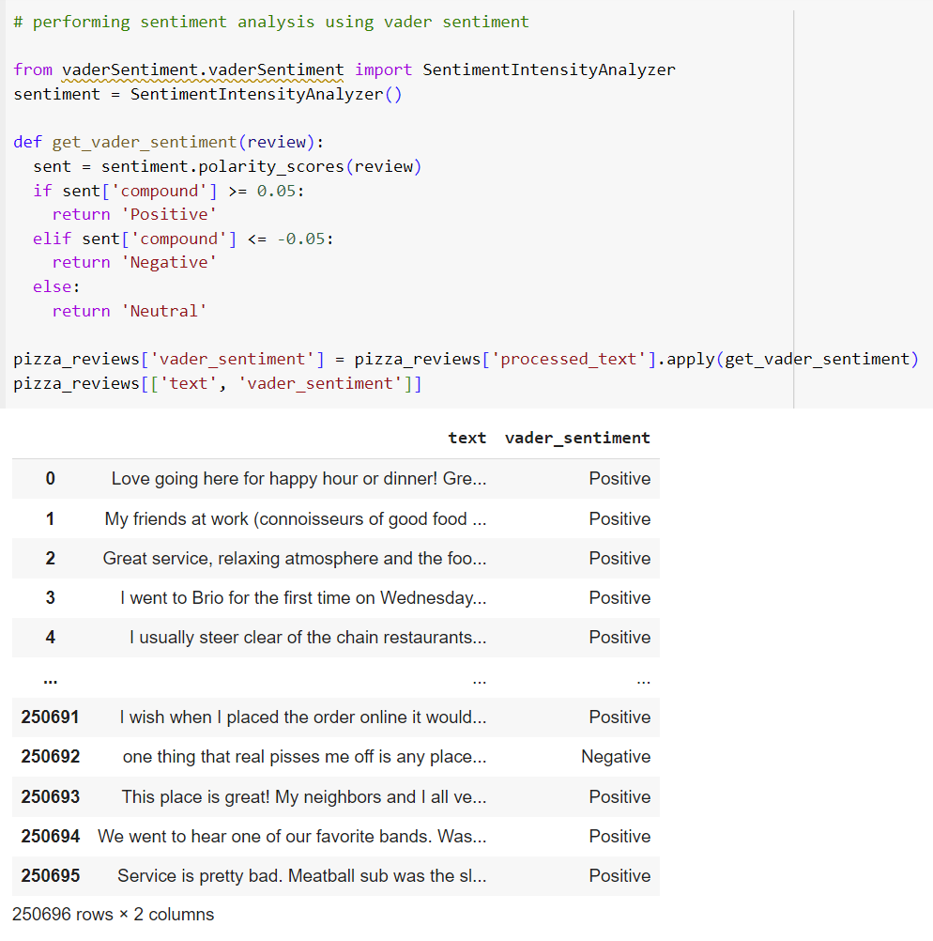
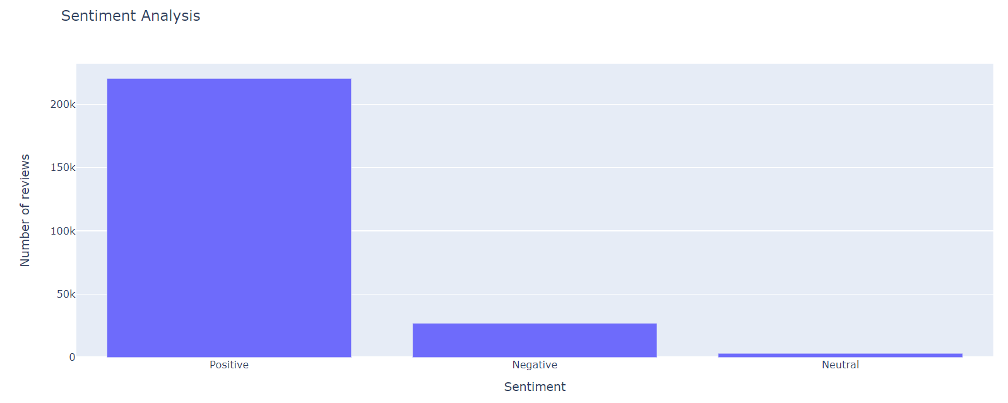
Data analysis – Sentiment analysis (Predictive analytics)
Motivation – Causes for customer satisfaction can be analyzed from positive reviews and causes of customer dissatisfaction can be analyzed from negative reviews.
Method – Lexicon based, Vader Sentiment
Majority of the dataset consists of positive reviews.
Notes:
We want to understand the root causes for customer satisfaction and dissatisfaction. We can get this information from positive and negative reviews. To know which reviews are positive and which reviews are negative, we performed sentiment analysis.
We do not already have the label (sentiment) with us in the dataset, so we cannot use a supervised learning machine learning model to predict the sentiment. We also have a lot of data to work with. Thus, to save on computational complexity and time, we used the lexicon based approach to perform sentiment analysis. We used vader sentiment because it gives us a relatively quick and accurate enough sentiment analysis. Its also a popular approach to perform sentiment analysis.
After performing the sentiment analysis, you can see that majority of the reviews we are working with are positive in nature.

Slide 8
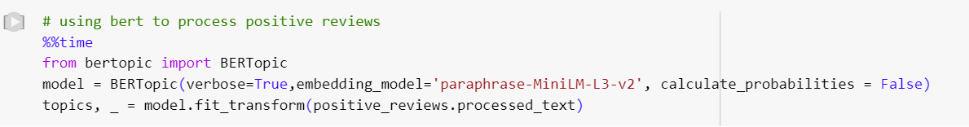
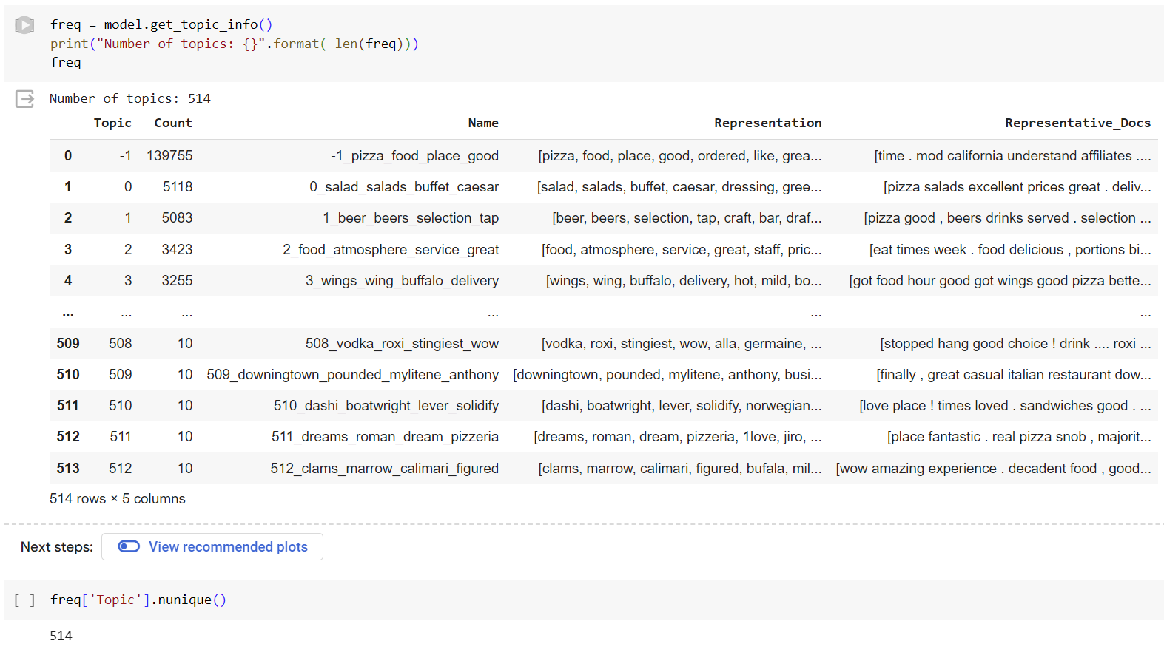
Data Analysis – Topic Modeling
Method used: BERT
Motivation:
Used when input is complex, and output is not.
Transformer-based model: computationally efficient
Bidirectional – Captures the meaning of the word more accurately
Pre trained model – improves performance
Do not have to decide the number of topics before hand.
Number of topics identified for positive reviews: 514
Notes:
After knowing which reviews are positive and which reviews are negative, we perform topic modeling on each class of these reviews to know what are the major topics in positive reviews and what are the major topics in the negative reviews. The topics identified from positive reviews will be the root causes for customer satisfaction and the topics from negative reviews will be the root causes for customer dissatisfaction.
We used BERT to perform topic modeling. We used BERT because:
It is useful for scenarios where the input is a complex and the output is not. Here the input are the pizza restaurant reviews and the output is just a list of topics covered in the reviews.
It is a transformer-based model – It is not sequential which drastically improves computational efficiency.
It is bidirectional – it considers the context of the word in relation to both its left and right context in a sentence. It captures the meaning of the word more meaningfully, which is important for identifying accurate and coherent topics.
It is a pre trained model which uses transfer learning – Its already trained on massive amount of data and it can be fine tuned to perform our own task, which gives us a better performance.
We do not have to decide the number of topics before hand.
3. BERT identified 514 unique topics. Of course, not all of these topics are interpretable or meaningful.

Slide 9
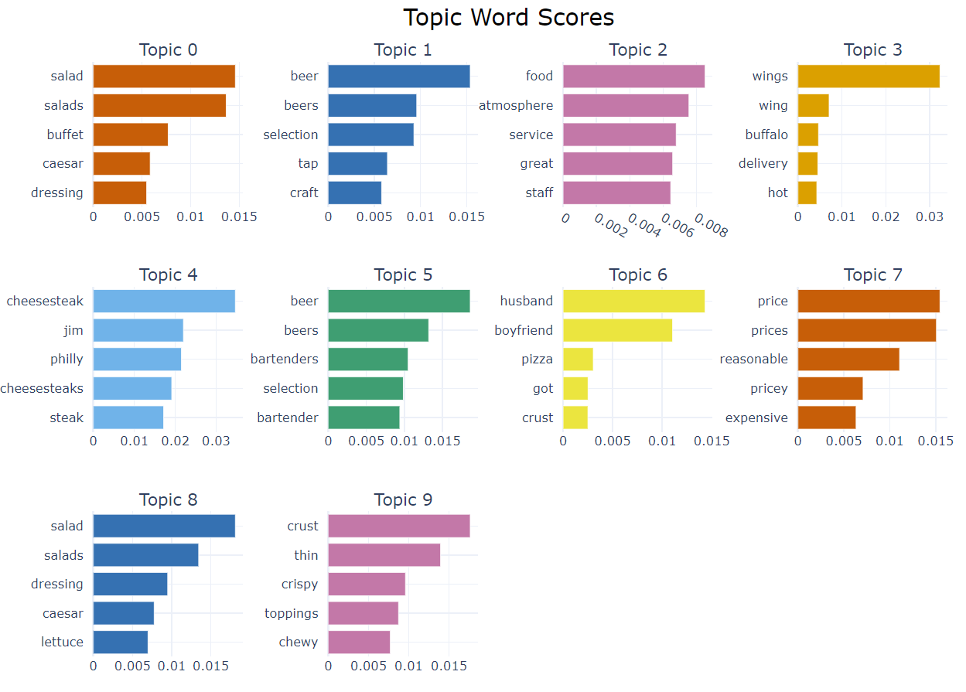
Data analysis – Topic Modeling for positive reviews
Interpretable topics:
Topic 0 and 8: Good salads and dressings
Topic 1 and 5: Good bartender and beer selections
Topic 2: Good food, atmosphere and staff
Topic 7: Reasonable prices
Topic 9: Good toppings and crust
Notes:
We cannot sit and interpret 514 topics, so we chose to analyze the top 10 topics. Not all of the topics were interpretable and some of the topics were very similar to each other. Topic 0 and 8: Good salads and dressings
Topic 1 and 5: Good bartender and beer selections
Topic 2: Good food, atmosphere and staff
Topic 7: Reasonable prices
Topic 9: Good toppings and crust

Slide 10
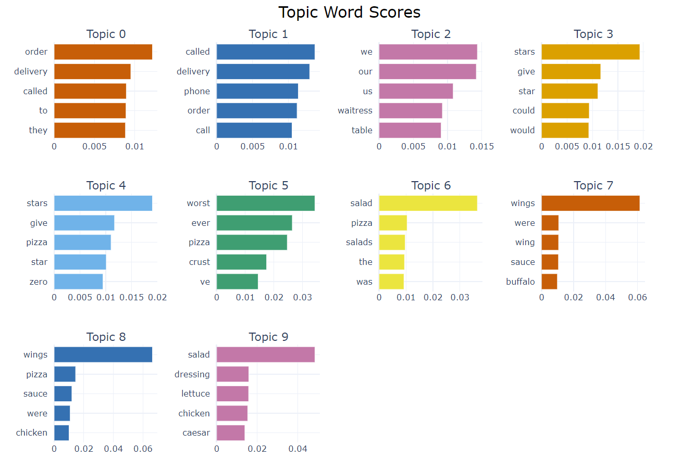
Data Analysis – Topic modeling for negative reviews
Total number of topics identified: 109
Interpretable topics:
Topic 0: Order Delivery Issues.
Topic 1: Phone Communication Problems.
Topic 2: Restaurant tables and waitresses.
Topic 5: Bad Pizza Crust.
Topic 6 and 9: Poor salad and dressing.
Topic 7 and 8: Subpar wings.
Notes:
We then performed topic modeling for negative reviews, using BERT, to identify root causes for customer dissatisfaction.
109 topics were identified – we analyzed only the top 10 – some topics were not interpretable, and some topics were similar to each other.
Topic 0: Order Delivery Issues.
Topic 1: Phone Communication Problems.
Topic 2: Restaurant tables and waitresses.
Topic 5: Bad Pizza Crust.
Topic 6 and 9: Poor salad and dressing.
Topic 7 and 8: Subpar wings.

Slide 11
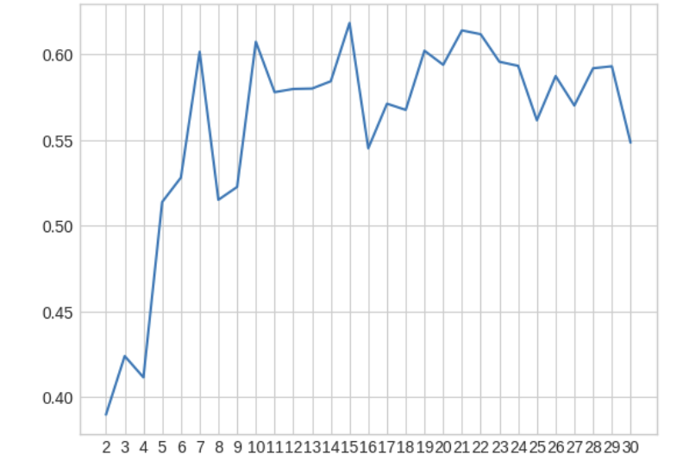
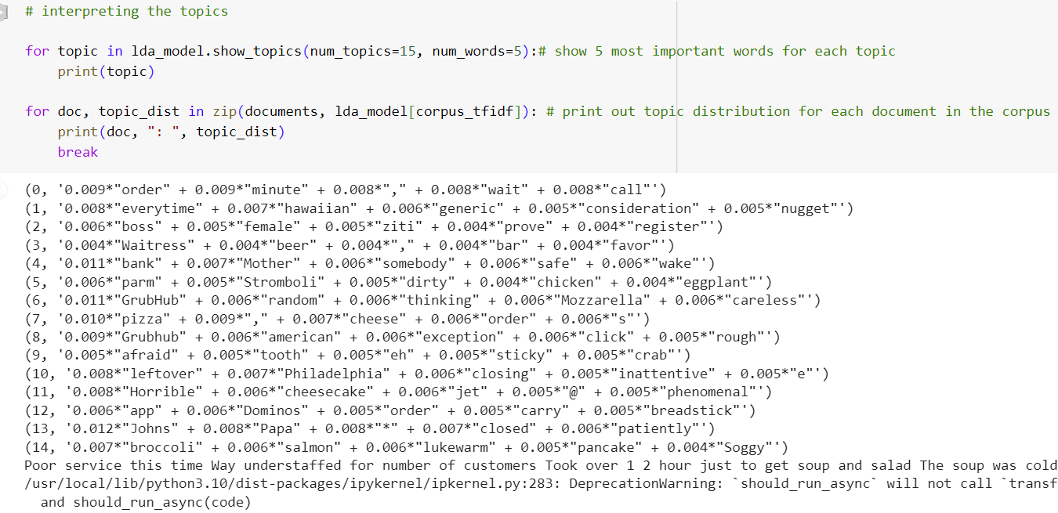
Data Analysis – Topic modeling for negative reviews using LDA with TF-IDF quantification
Ideal number of topics based on coherent score: 15
Interpretable topics:
Topic 0: Waiting time and phone communication problems
Topic 1: Generic or limited menu
Topic 3: Waitress problems
Topic 4: Dirty food
Topic 6: Being careless
Topic 10 and 13: Closing time soon
Topic 14: Lukewarm and soggy food
Notes:
Since our main focus is on improving pizza restaurants by identifying root causes of customer dissatisfaction, we performed topic modeling using different approaches, to check if any new topics could be identified.
We performed topic modeling for negative reviews using LDA with a TF-IDF quantification. Topic 0: Order Delivery Issues.
Topic 1: Phone Communication Problems.
Topic 2: Restaurant tables and waitresses.
Topic 5: Bad Pizza Crust.
Topic 6 and 9: Poor salad and dressing.
Topic 7 and 8: Subpar wings.

Slide 12
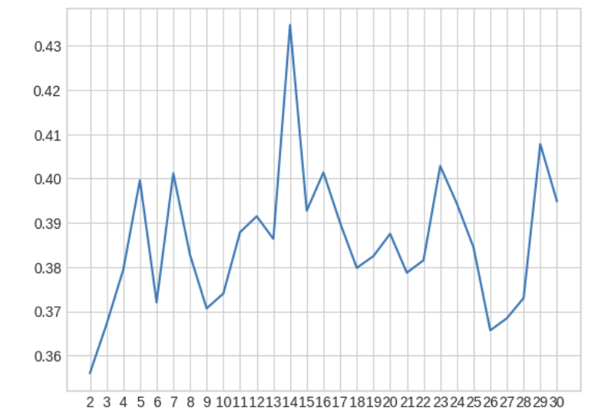
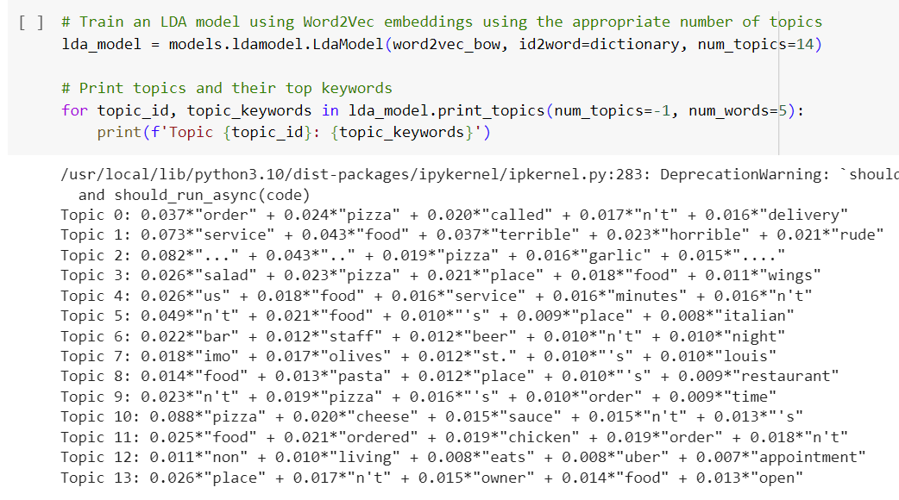
Data Analysis – Topic modeling for negative reviews using LDA with word2vec quantification
Ideal number of topics based on coherent score: 14
Interpretable topics:
Topic 0: Delivery and phone communication issues.
Topic 1: Terrible food and service
Topic 9: Long waiting time for order placed
Notes:
We then perform topic modeling on negative reviews using LDA with word2vec quantifications.
Ideal number of topics based on coherent score: 14
Interpretable topics:
Topic 0: Delivery and phone communication issues.
Topic 1: Terrible food and service
Topic 9: Long waiting time for order placed

Slide 13
Insights from data analysis
Root causes for customer satisfaction | Root causes for customer dissatisfaction
Good food – all types of food, not just pizza | Order delivery issues
Good drinks | Phone communication problems
Good atmosphere | Table issues – might be related to availability of them on time / not enough
Good staff | Staff / waitress issues – being careless
Reasonable prices | Bad / Unhygienic food – all types of food, not just pizza
Good pizza crust and toppings | Bad pizza crust
 | Long waiting time
 | Limited menu
 | Closing time too soon
Notes:
From looking at the topics found in positive and negative reviews, we can infer the following root causes for customer satisfaction and dissatisfaction.
The root causes for customer satisfaction are:
Good food – all types of food, not just pizza. We noticed that even if the pizza is good, if other food items on the menu, like salads and wings, are not good, the pizza restaurant receives low ratings which might lead to them losing customers.
Good drinks
Good atmosphere
Good staff
Reasonable prices
Good pizza crust and toppings
The root causes for customer dissatisfaction are:
Order delivery issues
Phone communication problems
Table issues – might be related to availability of them on time / not enough
Staff / waitress issues – being careless
Bad / Unhygienic food – all types of food, not just pizza
Bad pizza crust
Long waiting time
Limited menu
Closing time too soon

Slide 14
Recommendations based on data analysis – Prescriptive analytics
Improve delivery efficiency
Optimize delivery routes
Set realistic delivery time estimates
Improve phone communication problems
Train staff for effective communication
Reduce phone orders – online ordering system
Improve staff
Train waitresses and staff to be friendly and efficient.
Improve food quality
For pizzas – good crust and toppings
Rest of the food items and drinks should also be good.
Maintain hygiene
Conduct regular inspections to ensure cleanliness
Implement strict standards
Update the menu
Train them to not be careless – attention to detail and care in food preparation
Offer more variety
Regularly update menu to keep it fresh and appealing
Closing hours
Clearly communicate closing hours to customers
Extend operating hours if feasible
Prices
Prices should be reasonable and competitive
Notes:
Thus, based on our analysis, these are our recommendations for pizza restaurants to improve and maintain a good position in a competitive market.

Slide 15
Thank you

